Slide 1
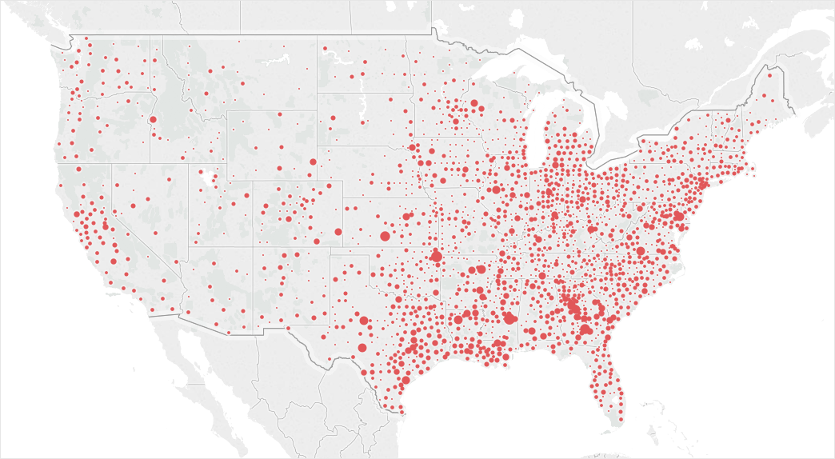
Religious geography and online gender harassment
Joey Marshall
Dept. of Sociology
Purdue University

Slide 2
Misogyny on Twitter varies by the religious composition of U.S. counties
County % affiliated
Expressions of misogyny or harassment on Twitter
County % Evangelical
County % Mainline
County % Catholic

Slide 3
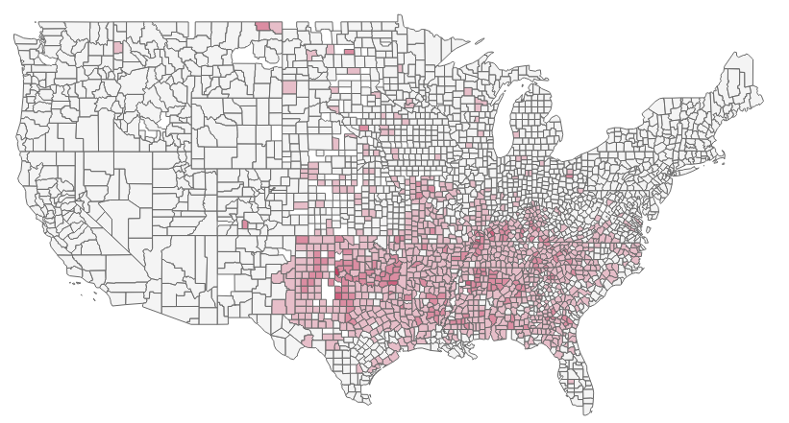
The religious composition of geographic areas matters for a variety of outcomes
Racial residential segregation (Blanchard 2007)
Divorce rates (Glass and Levchak 2014)
Aggregate mortality risk (Blanchard et al. 2008)
Early transitions to adulthood (Keister 2008, 2011; Sherkat 2014)
Lifetime accumulation of income and education
County proportion evangelical Protestant
RCMS 2010

Slide 4
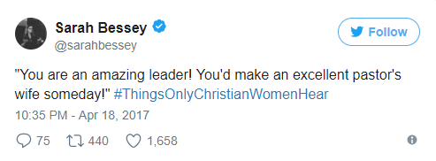
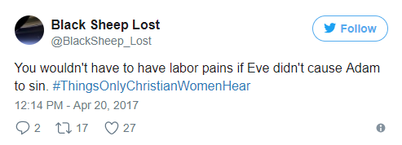
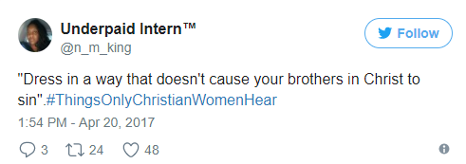
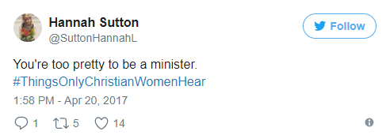
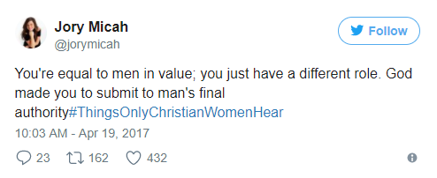
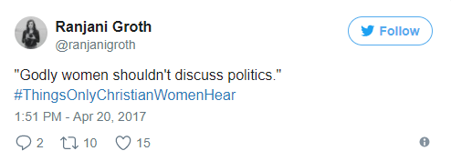
Gendered norms vary as a function of religious environment
Churches as gendered religious institutions (Leamaster and Subramaniam 2015)
Evangelicals: “soft patriarchy” (Wilcox 2004) versus “benevolent sexism” (Glicke and Fiske 2001)
In abusive relationships, churches may be havens or prisons (Giesbrecht and Sevcik 2000; Levitt and Ware 2006)

Slide 5

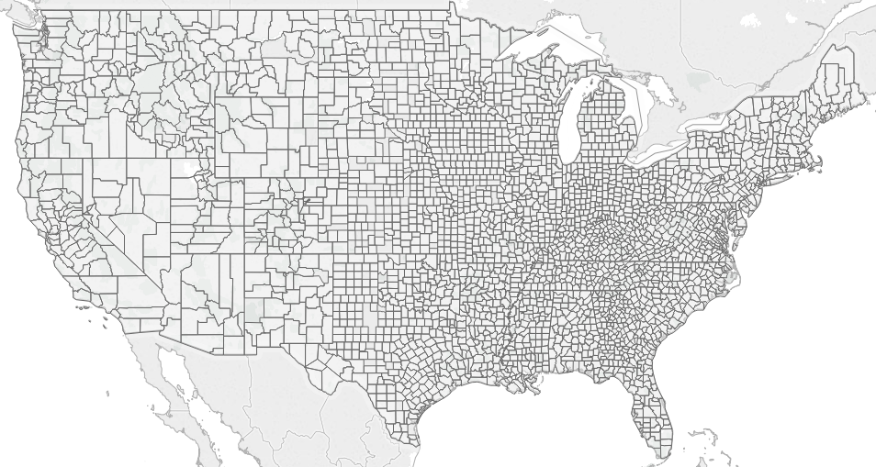
Data consist of geocoded tweets matched to other county-level data
Tweets
n = 4,358,750
Collected via Twitter’s stream API
Text
Lat/lon, matched to county FIPS code
Counties
n = 2,929 (1,994 with 30+ tweets)
Religious congregations and membership study
Census data
FBI’s Uniform Crime Reports
Voting data

Slide 6
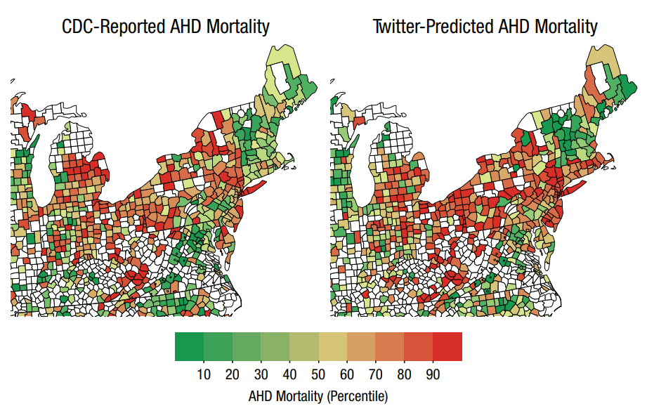
Tweets as data
Strengths
Limitations
Scale
Unobtrusive
Can get geo data
Predictive of real-world outcomes, e.g. heart mortality risk
Not representative
SES bias
Most tweets aren’t geocoded
English-only
General limitations of machine learning/NLP
Figure 3 from Eichstaedt, Johannes C., Hansen Andrew Schwartz, Margaret L. Kern, Gregory Park, Darwin R. Labarthe, Raina M. Merchant, Sneha Jha, Megha Agrawa, Lukasz A. Dziurzynski, Maarten Sap, Christopher Weeg, Emily E. Larson, Lyle H. Ungar and Martin E. P. Seligman. 2015. "Psychological Language on Twitter Predicts County-Level Heart Disease Mortality." Psychological Science Published online January 20, 2015.

Slide 7
Analysis stage 1: identify harassment or misogyny in tweets
Filter tweets using “harassment dictionary”
Read and hand-label a random sample
Train model for a second round of filtering
n = 42,776
n = 1,000
n = 37,571

Slide 8
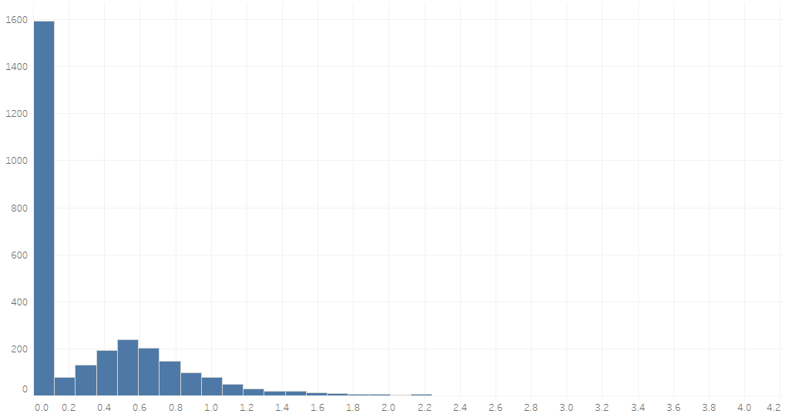
Analysis stage 2: match tweets to counties and predict harassment frequency
Calculate county-level proportion of misogynistic tweets
Merge tweets with other county data
Regression models to predict misogyny/harassment
Tobit models to account for overdispersion
Log(county proportion of harassing tweets)

Slide 9
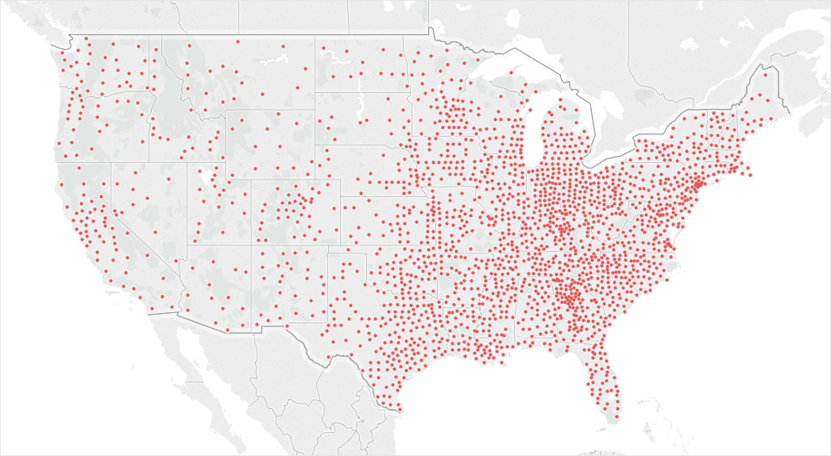
Coverage map
Dots represent counties with at least 30 tweets

Slide 10
Harassment map
Larger dots represent counties with more harassment as a proportion of total twitter traffic

Slide 11
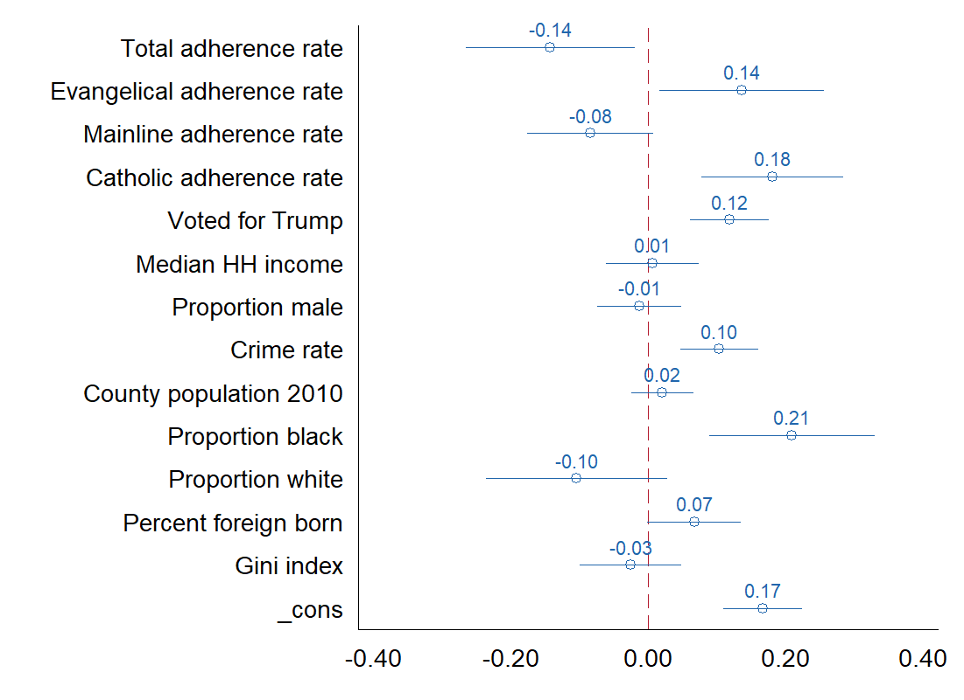
Twitter misogyny more frequent in highly evangelical and
Catholic counties, less frequent in highly mainline counties
Standardized regression coefficients from multivariate tobit model predicting county-level proportion of harassing tweets

Slide 12
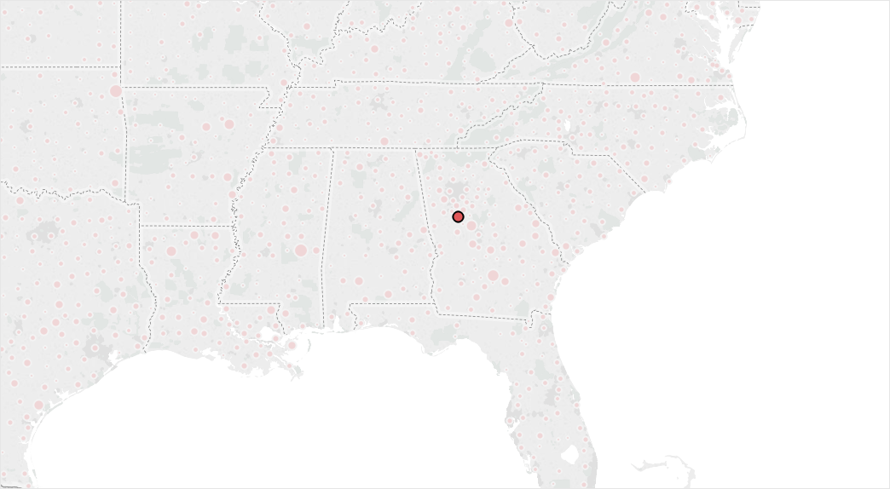
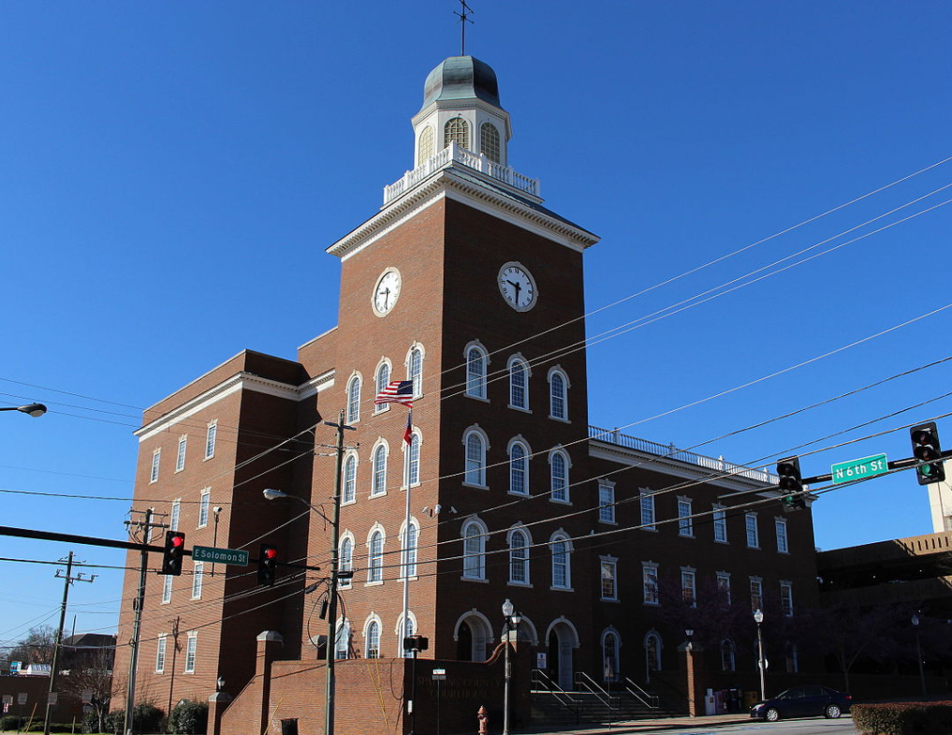
Spalding County, GA
Population: 64,073
Median HH income: $40,655
Crime rate: 2.8 X nat’l avg.
Religious adherence: 731 per 1,000
Evangelical adherence: 549 per 1,000
Mainline adherence: 104 per 1,000 Percent harassment: 5.3% of 264 tweets

Slide 13
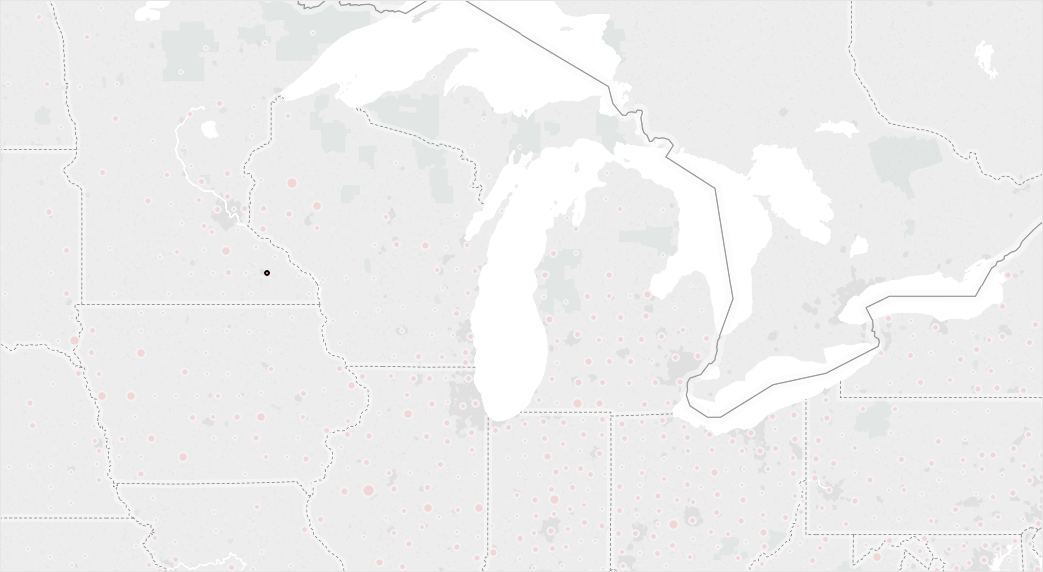
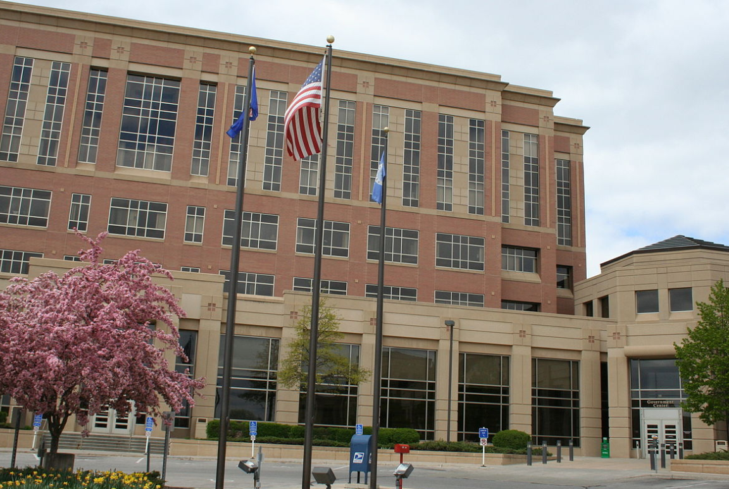
Olmsted County, MN
Population: 144,248
Median HH income: $66,667
Crime rate: 93% of nat’l avg.
Religious adherence: 640 per 1,000
Evangelical adherence: 183 per 1,000
Mainline adherence: 198 per 1,000 Percent harassment: 0% of 500 tweets

Slide 14

Conclusions
Misogyny on Twitter varies as a function of religious geography, net of controls for basic demographics, crime, and voting patterns
It’s very difficult to detect harassment in all its forms. Thankfully, a lot of smart people are working on this.
This method could be applied to other forms of harassment or rarely-occurring linguistic sentiments.
Theoretical contribution: religious context matters.
Download my code at github.com/marsha5813/conferences

Slide 15
Religious geography and online gender harassment
Joey Marshall
Dept. of Sociology
Purdue University

Slide 16
References
Blanchard, Troy C. 2007. "Conservative Protestant Congregations and Racial Residential Segregation: Evaluating the Closed Community Thesis in Metropolitan and Nonmetropolitan Counties." American Sociological Review 72(3):416-33.
Blanchard, Troy C., John P. Bartkowski, Todd L. Matthews and Kent R. Kerley. 2008. "Faith, Morality and Mortality: The Ecological Impact of Religion on Population Health." Social Forces 86(4):1591-620.
Glass, Jennifer and Philip Levchak. 2014. "Red States, Blue States, and Divorce: Understanding the Impact of Conservative Protestantism on Regional Variation in Divorce Rates." AJS 119(4):1002-46.
Glick, Peter and Susan T. Fiske. 2001. "An Ambivalent Alliance. Hostile and Benevolent Sexism as Complementary Justifications for Gender Inequality." American Psychologist 66(2):109-18.
Keister, Lisa A. 2008. "Conservative Protestants and Wealth: How Religion Perpetuates Asset Poverty." American Journal of Sociology 113(5):35p.
Keister, Lisa A. 2011. Faith and Money : How Religion Contributes to Wealth and Poverty. New York: Cambridge University Press.
Leamaster, Reid J. and Mangala Subramaniam. 2015. "Career and/or Motherhood? Gender and the Lds Church." Sociological Perspectives.
Sherkat, Darren E. 2014. Changing Faith: The Dynamics and Consequences of Americans' Shifting Religious Identities. New York: NYU Press.
Wilcox, W. Bradford. 2004. Soft Patriarchs, New Men: How Christianity Shapes Fathers and Husbands: University of Chicago Press.

Slide 17
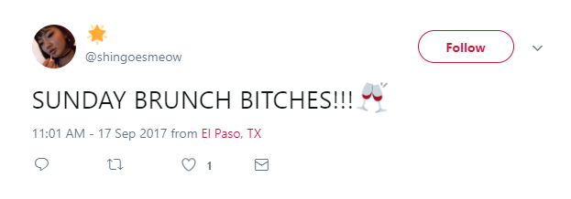
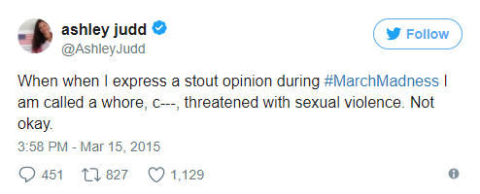
Gendered slurs sometimes occur outside the context of direct harassment
Humor that isn’t explicitly misogynistic
Women defending other women or recounting a personal experience of harassment

Slide 18
. sum mprtrate, detail
MPRTRATE
-------------------------------------------------------------
Percentiles Smallest
1% 6.46 .51
5% 18.35 .82
10% 29.85889 .9 Obs 2,913
25% 52.42889 .97 Sum of Wgt. 2,913
50% 84.21889 Mean 111.7112
Largest Std. Dev. 94.43911
75% 140.3189 666.94
90% 225.33 676.96 Variance 8918.746
95% 305.8389 771.2689 Skewness 2.237744
99% 473.22 835.37 Kurtosis 10.11465
. sum evanrate, detail
EVANRATE
-------------------------------------------------------------
Percentiles Smallest
1% 16.98 0
5% 38.84 2.85
10% 60.46889 3.6 Obs 2,913
25% 107.3789 3.97 Sum of Wgt. 2,913
50% 187.5689 Mean 231.4096
Largest Std. Dev. 159.4926
75% 333.17 863.62
90% 467.5689 876.58 Variance 25437.89
95% 535.2789 987.83 Skewness .9812167
99% 669.8889 1308.69 Kurtosis 3.927965
.
. sum pctharassment_filtered if count>30, detail
pctharassment_filtered
-------------------------------------------------------------
Percentiles Smallest
1% 0 0
5% 0 0
10% 0 0 Obs 1,978
25% 0 0 Sum of Wgt. 1,978
50% .5351805 Mean .6870877
Largest Std. Dev. .8509036
75% .9877519 6.896552
90% 1.639344 7.692307 Variance .7240369
95% 2.15311 7.913669 Skewness 2.87323
99% 3.703704 8.571428 Kurtosis 18.0142
Counties w/ 30+ tweets: 1,994
Total tweets: 4,358,750
Total tweets w/ gender slur: 42776
Total tweets after filtering: 37571

Slide 19
Spalding:
+-------------------------------------------------------------------------------------------------------+
| fips | count | pcthar~t | totrate | evanrate | mprtrate | cathrate | pop2010 | pcthar~d | gin~2010 |
| 13255 | 264 | 5.681818 | 730.6789 | 549.23 | 104.45889 | 29.53 | 64073 | 5.30303 | .44 |
|-------------------------------------------------------------------------------------------------------|
| median~e | lnpcth~d | pro~2010 | cri~2000 | pbl~2010 | pfo~2010 | trump16 | pwh~2010 |
| 40655 | 1.841031 | .4845411 | .0649572 | .3282194 | .0317763 | 1 | .6265978 |
+-------------------------------------------------------------------------------------------------------+
Olmstead, MN
+--------------------------------------------------------------------------------------------------------+
| fips | count | pcthar~t | totrate | evanrate | mprtrate | cathrate | pop2010 | pcthar~d | gin~2010 |
| 27109 | 500 | 0 | 639.6589 | 182.78 | 198.43889 | 230.40889 | 144248 | 0 | .41 |
|--------------------------------------------------------------------------------------------------------|
| median~e | lnpcth~d | pro~2010 | cri~2000 | pbl~2010 | pfo~2010 | trump16 | pwh~2010 |
| 66667 | 0 | .4886376 | .0214353 | .0476263 | .0970759 | 0 | .8568923 |
n-ENSEMBLE COVERAGE n-ENSEMBLE RECALL
n >= 1 1.00 0.74
n >= 2 1.00 0.74
n >= 3 0.90 0.75
n >= 4 0.68 0.73
ALGORITHM PERFORMANCE
SVM_PRECISION SVM_RECALL SVM_FSCORE FORESTS_PRECISION
0.765 0.685 0.690 0.665
FORESTS_RECALL FORESTS_FSCORE TREE_PRECISION TREE_RECALL
0.520 0.435 0.790 0.665
TREE_FSCORE MAXENTROPY_PRECISION MAXENTROPY_RECALL MAXENTROPY_FSCORE
0.660 0.640 0.620 0.620

Slide 20
Summaries of all variables
Variable | Obs Mean Std. Dev. Min Max
-------------+---------------------------------------------------------
fips | 2,929 30406 14995.41 1001 56045
count | 2,929 1488.136 6852.614 1 211906
pctharassm~t | 2,929 .637859 1.60827 0 50
totrate | 2,929 508.694 171.6823 30.64889 1413.7
evanrate | 2,913 231.4096 159.4926 0 1308.69
-------------+---------------------------------------------------------
mprtrate | 2,913 111.7112 94.43911 .51 835.37
cathrate | 2,785 130.3017 132.9395 0 925.09
pctharassm~d | 2,929 .5412588 1.351275 0 50
lnpctharas~d | 2,929 .3117679 .4258188 0 3.931826

